Slide 1


Flexible and Efficient Library for Deep Learning
Big Data Ecosystems Paper Presentation based on “MXNet: A Flexible and Efficient Machine Learning Library for Heterogeneous Distributed Systems”
Big Data Ecosystems
Venkata Narendra Kumar Gutta
Abdul Muneer Kattubadi
Jayachandra Yarlagadda

Slide 2
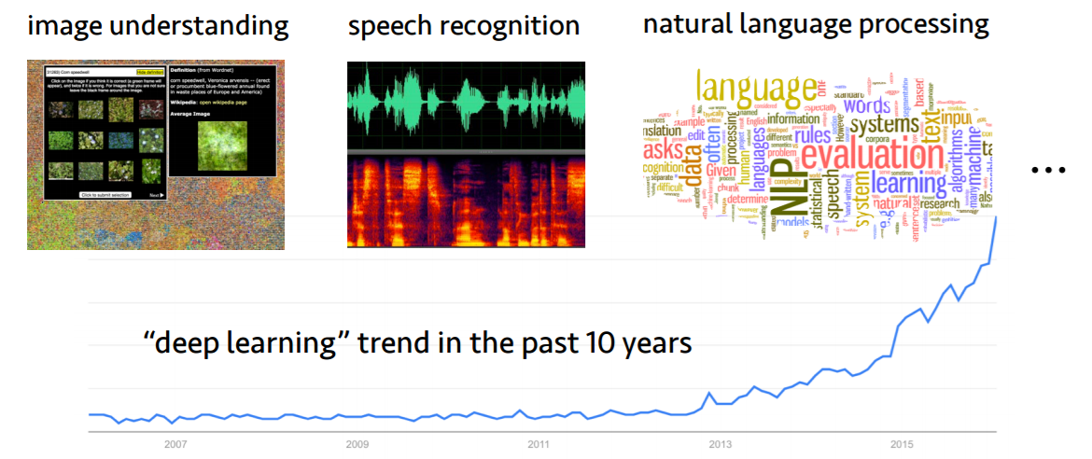
Motivation
Images Source: Google Images

Slide 3
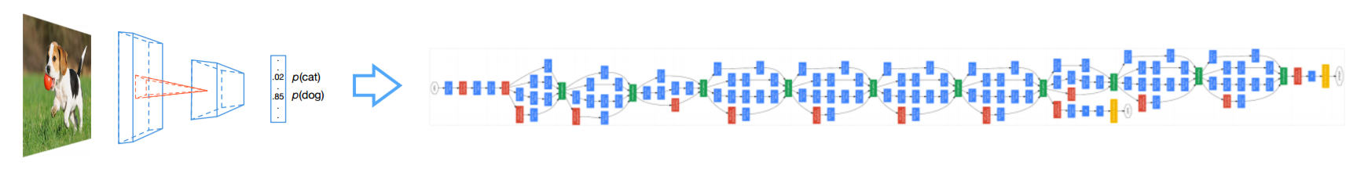
Motivation
State-of-the-art networks have tens to hundreds layers
Hard to define the network
the definition of the inception network has >1k lines of codes in Caffe
A single image requires billions floating-point operations
Intel i7 ~500 GFLOPS
Nvidia Titan X: ~5 TFLOPS
Memory consumption is linear with number of layers
Images Source: Google Images

Slide 4






Features
Flexible
Portable
Multiple Language Support
Supports both imperative and symbolic programming
Runs on CPUs or GPUs, on clusters, servers, desktops, or mobile phones
C++, Python, R, Scala, Julia, MATLAB and JavaScript - All with the same amazing performance.
Distributed on Cloud
Performance
Auto Differentiation
Supports distributed training on multiple CPU/GPU machines, including AWS, GCE, Azure, and Yarn clusters
Optimized C++ backend engine parallelizes both I/O and computation
Calculates the gradient automatically for training a model

Slide 5
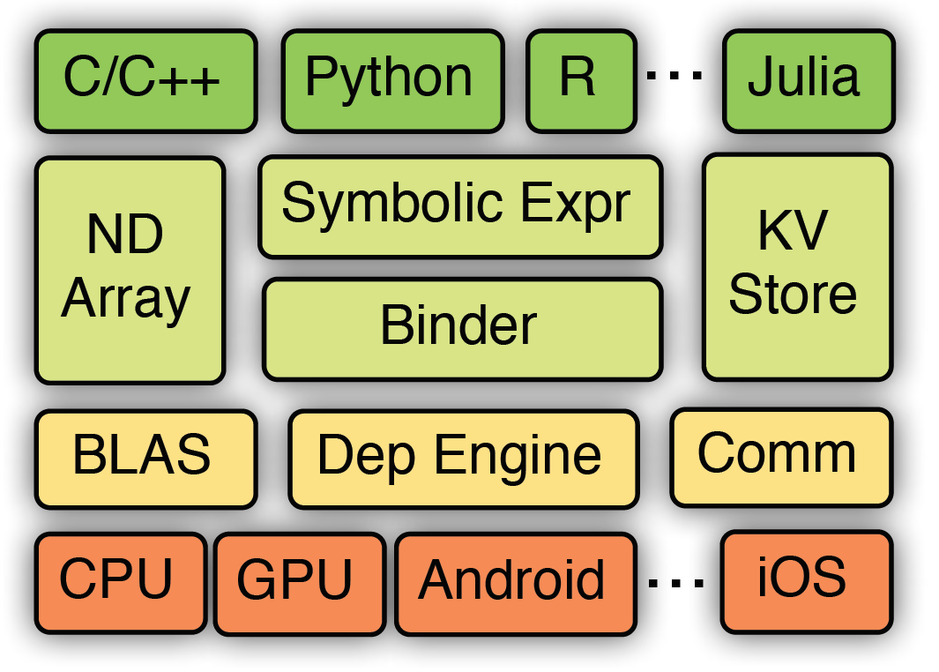
Application Programming Interface
Architecture - Overview
Symbol – Declarative symbolic expressions
NDArray
KV Store

Slide 6



Highlights
Efficiency
Mixed Programming API
Auto Parallel Scheduling
Portability
Distributed Computing
Language Supports
Memory Optimization
Flexibility
Runs Everywhere

Slide 7
Highlights
Efficiency
Mixed Programming API
Auto Parallel Scheduling
Portability
Distributed Computing
Language Supports
Memory Optimization
Flexibility
Runs Everywhere

Slide 8

Imperative vs. Declarative Programs
Flexibility
Mixed API programming
Imperative Programs are straight-forward and flexible
Takes advantage of native language features (loop, condition)
A
B
import numpy as np
a = np.ones(10)
b = np.ones(10) * 2
c = b * a
print(c)
d = c + 1
A = Variable(‘A’)
B = Variable(‘B’)
C = B * A
D = C + 1
f = compile(D)
d = f(A=np.ones(10), B=np.ones(10)*2)
C
X
+
Easy to tweak with python code

Slide 9
Imperative vs. Declarative Programs
Flexibility
Mixed API programming
Declarative programs see the entire graph
More chances for optimization
Easy to save and load the computation structure
A
B
import numpy as np
a = np.ones(10)
b = np.ones(10) * 2
c = b * a
print(c)
d = c + 1
A = Variable(‘A’)
B = Variable(‘B’)
C = B * A
D = C + 1
f = compile(D)
d = f(A=np.ones(10), B=np.ones(10)*2)
C
X
+
C cannot share memory with d, because it could be used in future
C can share memory with D, because C cannot be seen by user

Slide 10
MXNet: Mix the Flavors Together
Flexibility
Mixed API programming
>>>import mxnet as mx
>>> a = mx.nd.zeros((100, 50))
(100L, 50L)
>>> a.shape
>>> b = mx.nd.ones((100, 50))
>>> c = a + b
>>> b += c
Imperative NDArray API
>>>import mxnet as mx
>>> net = mx.symbol.Variable('data')
>>> net = mx.symbol.FullyConnected(data=net, num_hidden=128)
>>> net = mx.symbol.SoftmaxOutput(data=net)
>>> type(net)
<class ‘mxnet.symbol.Symbol’>
>>> texec = net.simple_bind(data=data_shape)
Declarative Symbolic Executor

Slide 11
Symbol
Flexibility
Mixed API programming
One of the objects in MXNet is the Symbol provided by mxnet.symbol, or mxnet.sym for short.
These are composed by operators, such as simple matrix operations (e.g. +) or a complex neural network layer (e.g. convolutional layer)
load, save, memory estimation, and visualization, are also provided for symbols

Slide 12
Symbol (contd)
Flexibility
Mixed API programming
Here is an operation that shows usage of symbol variable
import mxnet as mx
a = mx.sym.Variable('a')
b = mx.sym.Variable('b')
c = a + b
(a, b, c)
(<Symbol a>, <Symbol b>, <Symbol _plus0>)

Slide 13
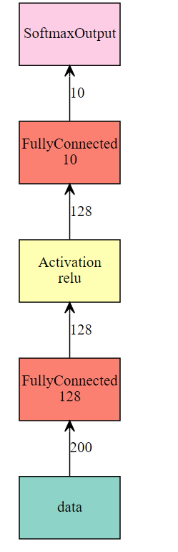
Symbol (contd)
Flexibility
Mixed API programming
Besides the basic operations, symbol has rich set of neural network layers
Below is the code to construct a fully connected neural network
net = mx.sym.Variable('data') # The first fully-connected layer
net = mx.sym.FullyConnected(data=net, name='fc1', num_hidden=128) # Apply relu to the output of the first fully-connnected layer
net = mx.sym.Activation(data=net, name='relu1', act_type="relu")
# The 2nd fcc
net = mx.sym.FullyConnected(data=net, name='fc2', num_hidden=10)
# The softmax
net = mx.sym.SoftmaxOutput(data=net, name='out')
mx.viz.plot_network(net, shape={'data':(100,200)})

Slide 14
Flexibility
Mixed API programming
NDArray – Imperative Tensor computation
One of the main object in MXNet is the multidimensional array provided by the package mxnet.ndarray, or mxnet.nd for short.
mxnet.ndarray is similar to numpy.ndarray in many aspects.
Some important attributes of a NDArray object are:
ndarray.shape - The dimensions of the array. It is a tuple of integers indicating the length of the array in each dimension. For a matrix with n rows and m columns, the shape will be (n, m).
ndarray.dtype - An numpy object describing the type of the elements.
ndarray.size - The total number of numbers in the array, which equals to the product of the elements of shape
ndarray.context - The device this array is stored. A device can be the CPU or the i-th GPU.
NDArray can be used combined with symbol as well

Slide 15
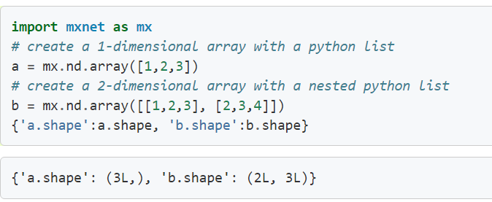
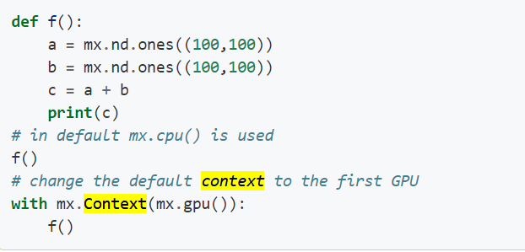
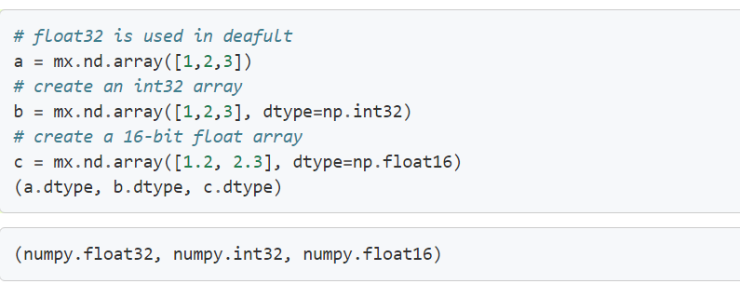
NDArray(Ctd.)
Flexibility
Mixed API programming
NDArray (continued)

Slide 16
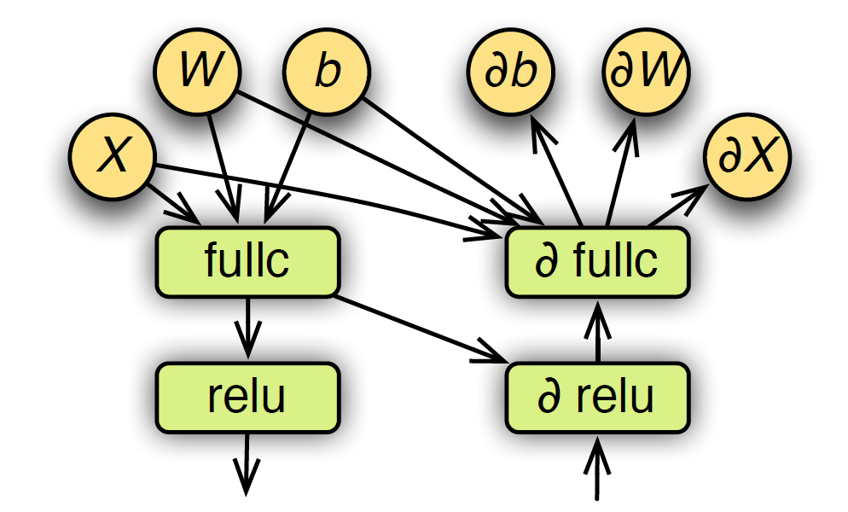
Computation Graph
Flexibility
Mixed API programming
Symbolic expression is presented
as graph for evaluation.
MXNet transforms the graph
to optimize the efficiency and
allocate memory to internal variables.
Computation graph for both forward and backward

Slide 17
Dependency Engine
Flexibility
Mixed API programming
In MXNet, each source units, is registered to the engine with a unique tag.
Any operation is pushed to dependency engine with unique resource tag.
This engine will compute once all dependencies are resolved for this operation and uses multiple threads to perform the operation for better resource utilization

Slide 18
Highlights
Efficiency
Mixed Programming API
Auto Parallel Scheduling
Portability
Distributed Computing
Language Supports
Memory Optimization
Flexibility
Runs Everywhere

Slide 19
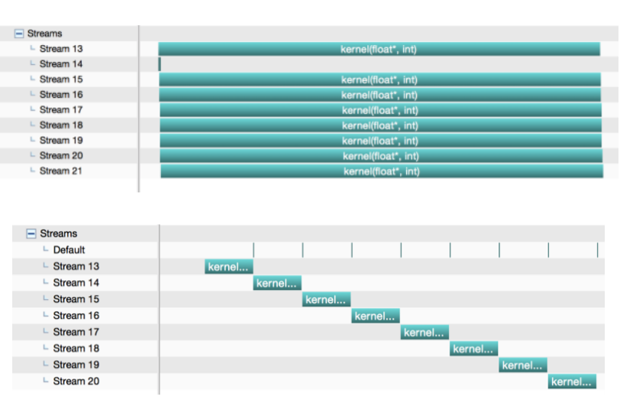
Need for Parallelization
Efficiency
Auto Parallel Scheduling
Fully Concurrent
Parallelize workload on multiple GPUs
Fine grained parallelization of small kernels
Overlap of memory copy with computation
Serial
Source: http://www.cs.cmu.edu/~muli/file/mxnet_gtc16.pdf

Slide 20
Efficiency
Auto Parallel Scheduling
Data Parallelism
MXNet uses data parallelism to partition the workload over multiple devices
If we have n devices , then each one will get the complete model and train 1/n of data.
Gradient and updated model are communicated across devices
Model Parallelism
In this parallelism, each device maintains a part of the model.
It is useful when the model is too large to fit into a single device.
Example: GoogleNet

Slide 21
Efficiency
Auto Parallel Scheduling
Workload Partitioning in Model Parallelism
Naïve Approach
Place each layer in one GPU
GPU doesn’t have to maintain memory for all layers
Optimum Strategy
Place neighbor layers in same GPU
Balance workload between GPUS
Different layers have different computation-memory properties Ex: LSTM vs Encoder

Slide 22
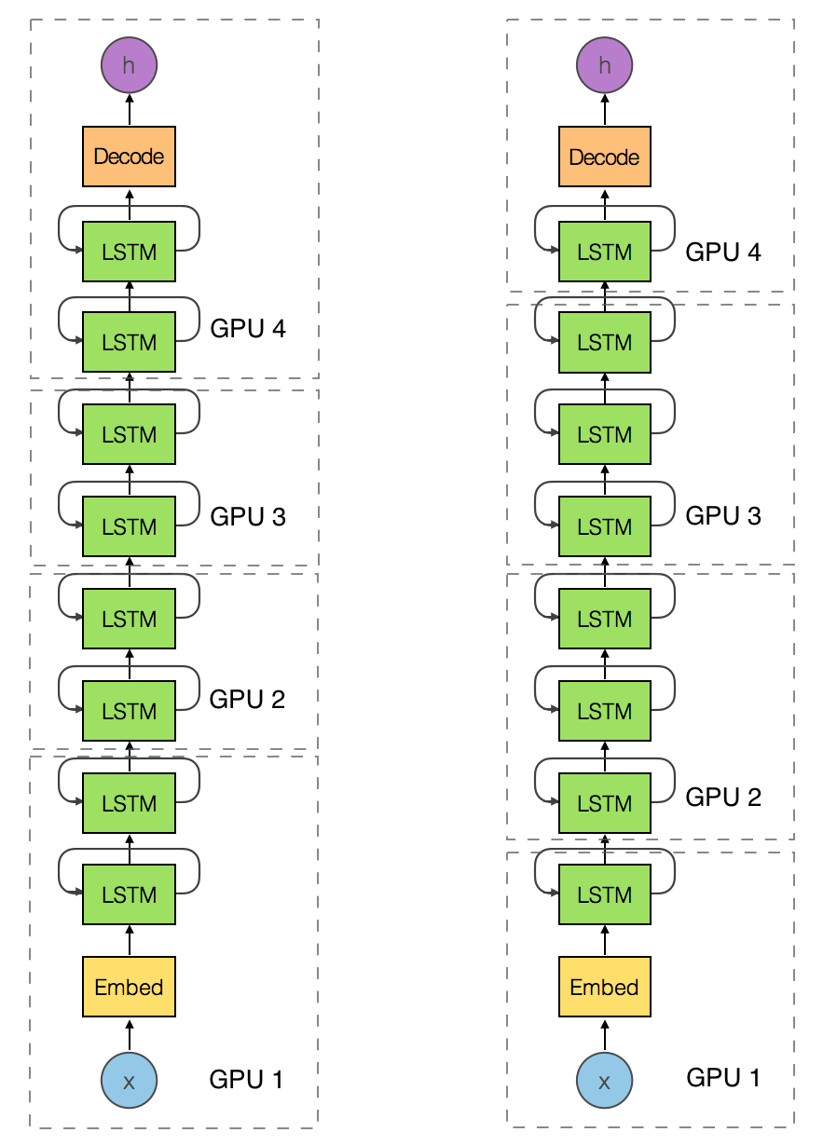
Efficiency
Auto Parallel Scheduling
Workload Partitioning in Model Parallelism
Both pipelines have 8 LSTM layers with encoder, decoder layer
Workload is more evenly distributed on the left one as per the optimal strategy

Slide 23



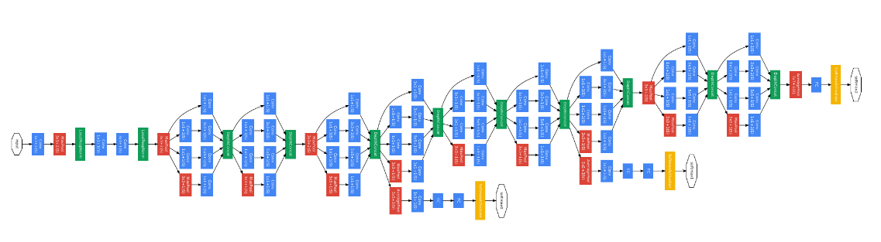
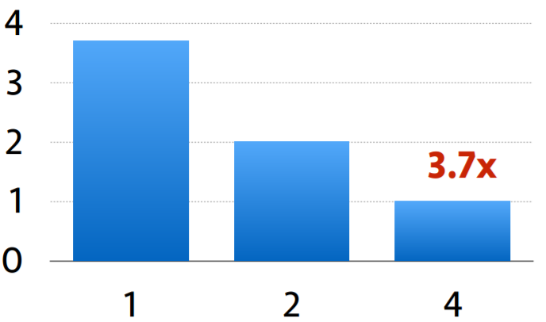
Results
Efficiency
Auto Parallel Scheduling
ImageNet with 1.2 Mil images and 1000 classes.
4x Nvidia GTX980
Google Inception Network.
Time for one Epoch.
hour
Number of GPUs

Slide 24
Highlights
Efficiency
Mixed Programming API
Auto Parallel Scheduling
Portability
Distributed Computing
Language Supports
Memory Optimization
Flexibility
Runs Everywhere

Slide 25
Efficiency
Distributed Computing
KVStore: Data Synchronization Over Devices
The KVStore is a distributed key-value store for data synchronization over multiple devices.
It supports two primitives: push a key-value pair from a device to the store, and pull the value on a key from the store.
while(1){ kv.pull(net.w); net.foward_backward(); kv.push(net.g); }

Slide 26
Efficiency
Distributed Computing
Synchronous vs Asynchronous Stochastic Gradient Descent
Synchronous: Uses Bulk Synchronous Protocol.
Aggregates gradients from all machines in each iteration before updating weight.
Asynchronous: In this, each machine updates the weight independently
Which one is better depends on many factors
Asynchronous is usually faster than synchronous because there is sync.
Synchronous guarantees convergence.
Convergence of Asynchronous is still an research topic.

Slide 27
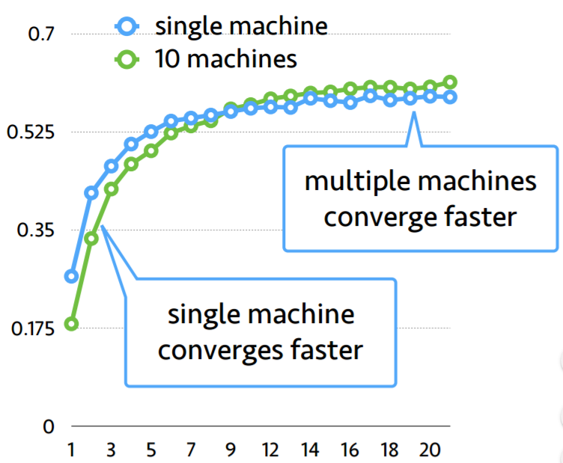
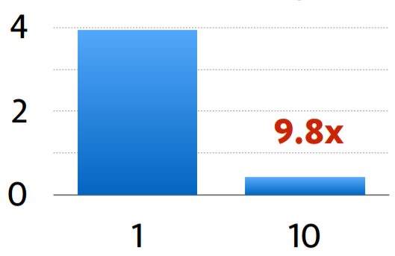
Results
Efficiency
Distributed Experiments
ImageNet with 1.2m images and 1000 classes.
Amazon EC2 GPU instance, 4 GPUs per machine
Google Inception Network.
The average cost of a data pass is 14K and 1.4K sec on a 1 machine and 10 machines respectively
accuracy
Time for one Epoch.
Hour
validation accuracy vs epoch
epochs
Number of GPUs

Slide 28
Highlights
Efficiency
Mixed Programming API
Auto Parallel Scheduling
Portability
Distributed Computing
Language Supports
Memory Optimization
Flexibility
Runs Everywhere

Slide 29



Flexibility
Language Support
frontend
backend
Single Implementation of backend system and common operators
Similar performance regardless of the front end used.

Slide 30

Flexibility
Language Support
MinPy : MXNet Numpy package
MinPy NumPy
Small operators (Numpy) + Big operators (MXNet)
>>> import numpy as np
>>> symbol = mx.symbol.FullyConnected(…)
>>> bigop = minpy.core.function(sigmoid, …)
>>> def training_loss(w, x, y):
pred = bigop(input=x, fc_weight=w)
prob = pred * y + (1 – pred) * (1 – y)
return –np.sum(np.log(prob))
>>> import minpy.numpy as np
MinPy has the same syntax as NumPy
Transparent CPU & GPU co-execution
Imperative style auto-differentiation
>>> x = np.zeros((10, 20)) # call GPU function
>>> y = np.sort(x) # call CPU function; copy GPU->CPU
>>> z = np.log(y) # call GPU function; copy CPU->GPU
>>> grad_func = minpy.core.grad_and_loss(train_loss)
>>> dw = grad_fn(w, x, y)

Slide 31
Highlights
Efficiency
Mixed Programming API
Auto Parallel Scheduling
Portability
Distributed Computing
Language Supports
Memory Optimization
Flexibility
Runs Everywhere

Slide 32
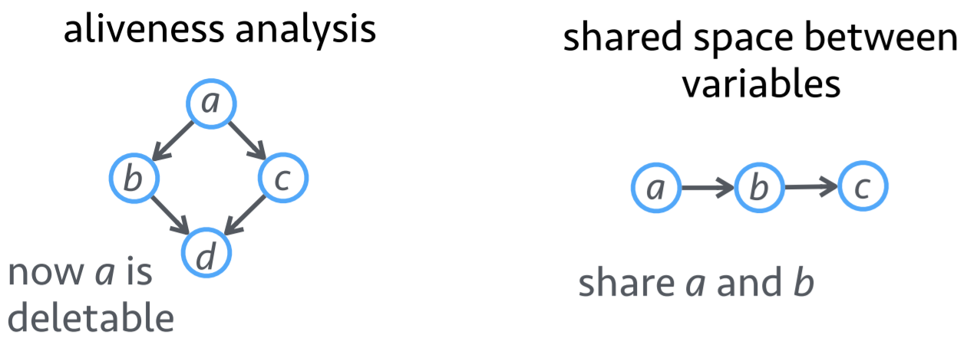
Efficiency
Memory Optimization
Traverse the computation graph to reduce the memory footprint with linear time complexity
In place Memory allocation
Co Share Memory allocation

Slide 33
Efficiency
Memory Optimization
Keeps a reference counter of dependent nodes that are not used so far, if the counter reaches zero memory is recycled.
While prediction we only need the forward graph, we don’t need the backward graph
To extract the features from internal layers, the last layers can be skipped.
Operators can be grouped. Ex: a*b+1 is replaced by single BLAS or GPU call.

Slide 34
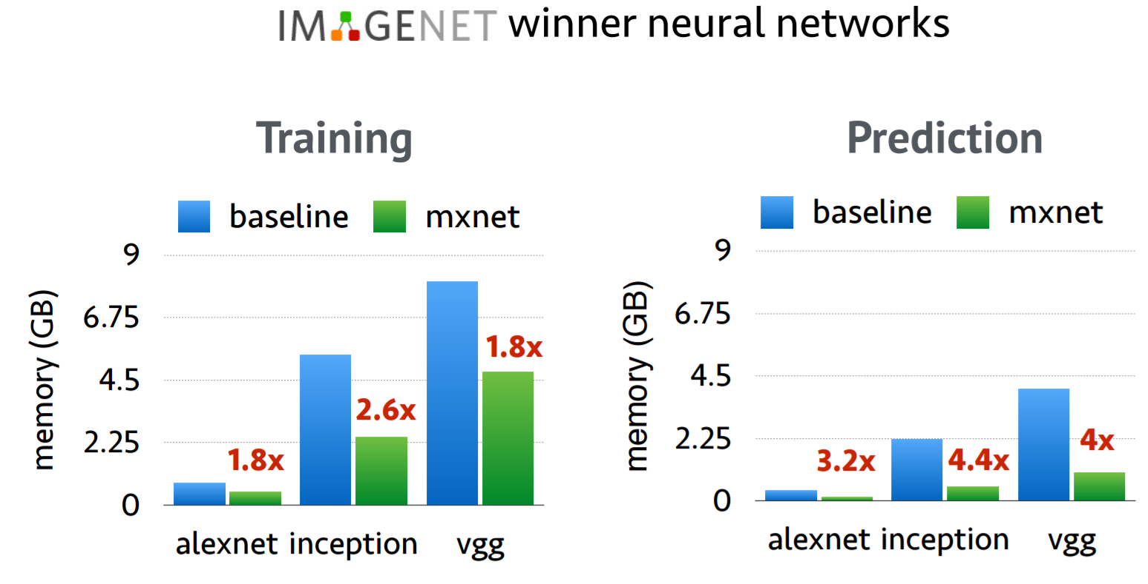
Results
Efficiency
Memory Optimization Experiments
Training:
Using MXNet reduced the memory usage by a 2x times.
Prediction:
MXNet uses almost 4x times less memory compared to the baselines.

Slide 35
Highlights
Efficiency
Mixed Programming API
Auto Parallel Scheduling
Portability
Distributed Computing
Language Supports
Memory Optimization
Flexibility
Runs Everywhere

Slide 36


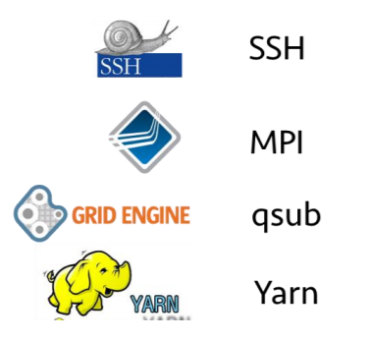

Portable
Train on the cloud
Consume data from distributed filesystems
Launch Distributed Jobs
easily extend to other cluster resource management software
… multithreaded read/write to hide network latency

Slide 37

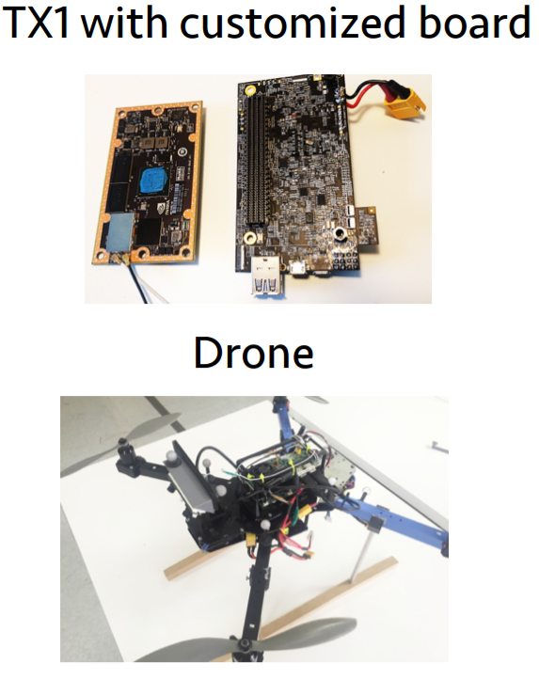
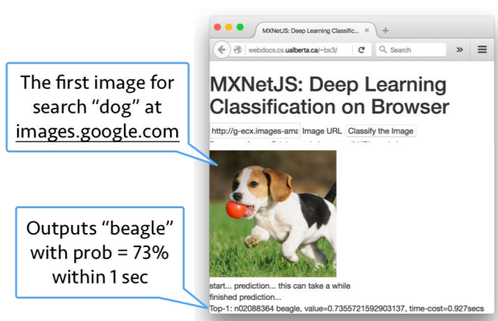



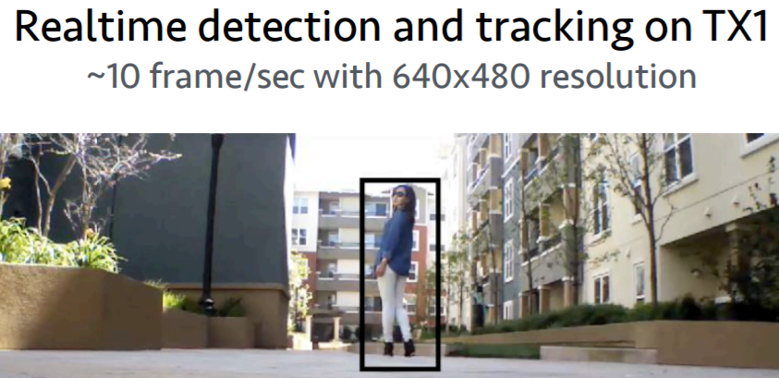
Portable
Deploy Everywhere
Amalgamation
Runs in a browser in with JavaScript
JETSON TX1 MODULE
Fit the core library with all the dependencies into a single C++ source file.
Easy to compile on
This AI supercomputer features NVIDIA 256 NVIDIA CUDA® cores, 64-bit CPUs, and a power-efficient design. Plus, it includes the latest technology for deep learning, computer vision, GPU computing, and graphics—making it ideal for embedded AI computing.

Slide 38
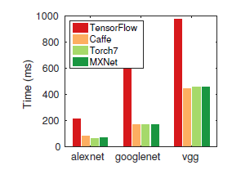


Comparison I
Memory
Great
Good (now)
Excellent
Single GPU* (complex graphs)
Comparable to CuDNNv4
About 0.5x slower*
Comparable to CuDNNv4
Parallel vs Distributed
Experimental Multi GPU
Multi GPU & Distributed
Distributed
Platform Support
All Major OS, Docker, Cloud AWS
All OS, Docker, Cloud AWS, Raspberry pi, Android
From distributed GPU Clusters to Embedded Systems
Compare MXNet to others on a single forward backward
performance. (single Nvidia GTX 980 card)
*LeNet model on MNIST Dataset using a Single-GPU (NVIDIA Quadro K1200 GPU)

Slide 39
Comparison II
Code Re-usability/
pre-trained models
Lasange – Built on Top of Theano
Keras, TFLearn- Built on top of TensorFlow
MXNet Caffe Converter
Low-level Tensor Operators
A lot of basic operations
Fairly Good
Very Few
Control flow Operators
Supported
Supported
Not Supported – but imperative model helps
Benchmarking using Single GPU*
Great
Good
Excellent
Data Reference: Strata+Hadoop Talk [Dec 2016] Transfer learning and fine-tuning deep neural network models across different domains
*LeNet model on MNIST Dataset using a Single-GPU (NVIDIA Quadro K1200 GPU)
Notes:
Code Re-usability
Training deep networks are time-consuming. So, Caffe has released some pre-trained model/weights (model zoo) which could be used as initial weights while transfer learning or fine tuning deep networks on domain specific or custom images.
Theano Lasagne is a high-level framework built on top of Theano. It’s very easy to use Caffe pre-tained model weights in Lasagne.
TensorFlow No support for pre-trained model.
MXNET MXNET has a caffe_converter tool which allows to convert pre-trained caffe model weights to fit MXNET.
Low-level Tensor Operators
A reasonably efficient implementation of low-level operators can serve as ingredients in writing new models, saving the effort to write new Operations.
Theano
TensorFlow
MXNET
A lot of basic Operations
Fairly good
Very few
Control Flow Operator
Control flow operators make the symbolic engine more expressive and generic.
Theano
TensorFlow
MXNET
Supported
Experimental
Not Supported
High-level Support
Theano Pure symbolic computation framework. High-level frameworks can be built to fit desired means of use. Successful examples include Keras, Lasagne, blocks.
TensorFlow Has good design considerations for neural network training, and at the same time avoid being totally a neural network framework, which is a wonderful job. The graph collection, queues, image augmenters etc. can be useful building blocks for a higher-level wrapper.
MXNET Apart from the symbolic part, MXNET also comes with all necessary components for image classification, going all the way through data loading to building a model that has a method to start training.
Performance
Benchmarking Using Single-GPU
I benchmark LeNet model on MNIST Dataset using a Single-GPU (NVIDIA Quadro K1200 GPU).
Theano
TensorFlow
MXNET
Great
Not so good
Excellent
Memory
GPU memory is limited and may usually be a problem for large models.
Theano
TensorFlow
MXNET
Great
Not so good
Excellent
Single-GPU Speed
Theano takes a long time to compile a graph, especially with complex models. TensorFlow is a bit slower.
Theano / MXNET
TensorFlow
comparable to CuDNNv4
about 0.5x slower
Parallel/Distributed Support
Theano
TensorFlow
MXNET
experimental multi-GPU
multi-GPU
distributed

Slide 40





Comparison III
Core
Binding Languages
Devices beyond CPU
Distributed
Imperative Program
Declarative Program
C++
Python/MATLAB
GPU
Lua
-
Lua
Python
-
Python
C++
Python
GPU/Mobile
C++
Python, R, Julia, Go, Javascript
GPU/Mobile
Compare to other popular open-source ML libraries
Notes:
Code Re-usability
Training deep networks are time-consuming. So, Caffe has released some pre-trained model/weights (model zoo) which could be used as initial weights while transfer learning or fine tuning deep networks on domain specific or custom images.
Theano Lasagne is a high-level framework built on top of Theano. It’s very easy to use Caffe pre-tained model weights in Lasagne.
TensorFlow No support for pre-trained model.
MXNET MXNET has a caffe_converter tool which allows to convert pre-trained caffe model weights to fit MXNET.
Low-level Tensor Operators
A reasonably efficient implementation of low-level operators can serve as ingredients in writing new models, saving the effort to write new Operations.
Theano
TensorFlow
MXNET
A lot of basic Operations
Fairly good
Very few
Control Flow Operator
Control flow operators make the symbolic engine more expressive and generic.
Theano
TensorFlow
MXNET
Supported
Experimental
Not Supported
High-level Support
Theano Pure symbolic computation framework. High-level frameworks can be built to fit desired means of use. Successful examples include Keras, Lasagne, blocks.
TensorFlow Has good design considerations for neural network training, and at the same time avoid being totally a neural network framework, which is a wonderful job. The graph collection, queues, image augmenters etc. can be useful building blocks for a higher-level wrapper.
MXNET Apart from the symbolic part, MXNET also comes with all necessary components for image classification, going all the way through data loading to building a model that has a method to start training.
Performance
Benchmarking Using Single-GPU
I benchmark LeNet model on MNIST Dataset using a Single-GPU (NVIDIA Quadro K1200 GPU).
Theano
TensorFlow
MXNET
Great
Not so good
Excellent
Memory
GPU memory is limited and may usually be a problem for large models.
Theano
TensorFlow
MXNET
Great
Not so good
Excellent
Single-GPU Speed
Theano takes a long time to compile a graph, especially with complex models. TensorFlow is a bit slower.
Theano / MXNET
TensorFlow
comparable to CuDNNv4
about 0.5x slower
Parallel/Distributed Support
Theano
TensorFlow
MXNET
experimental multi-GPU
multi-GPU
distributed

Slide 41
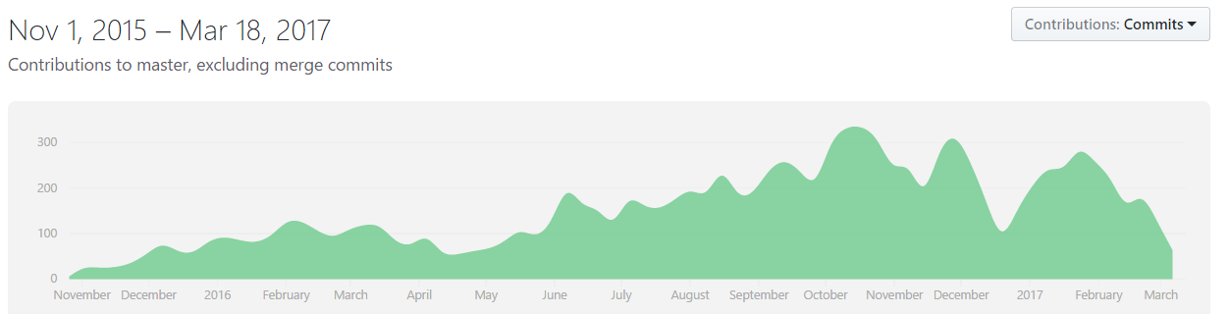
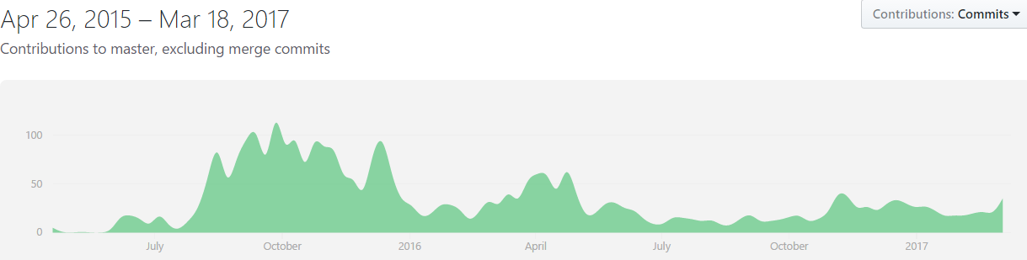
GIT Contributions

Slide 42

Improvements
Adding New Operations to frameworks like these (MXNet, tensorflow, theano) with reasonable performance is not easy.
High Level Wrappers around MXNet are comparatively rare. More contributors and frameworks can gain more traction.
A visual drag-drop tool using MXNet backend to create and model neural networks with

Slide 43

Interested in MXNet?
A Deeper Dive into Apache MXNet on AWS: Learn about the features and benefits of Apache MXNet, the AWS offering that is foundational to MXNet developers. [Wed, March 223:00:00 PM EDT - 4:00:00 PM EDT]
Learning Objectives:
• Learn about the features and benefits of Apache MXNet.
• Learn about the deep learning AMIs with the tools you need for DL.
• Learn how to train a neural network using MXNet.

Slide 44

th ank you
Resources
https://mxnet.io | https://aws.amazon.com/mxnet/ | http://dmlc.ml/
Images source: Google Images

